Slide 1
Introduction to Access – Part 4
Ways of Entering Data into an Access Database- Datasheet View and Access Form

Slide 2
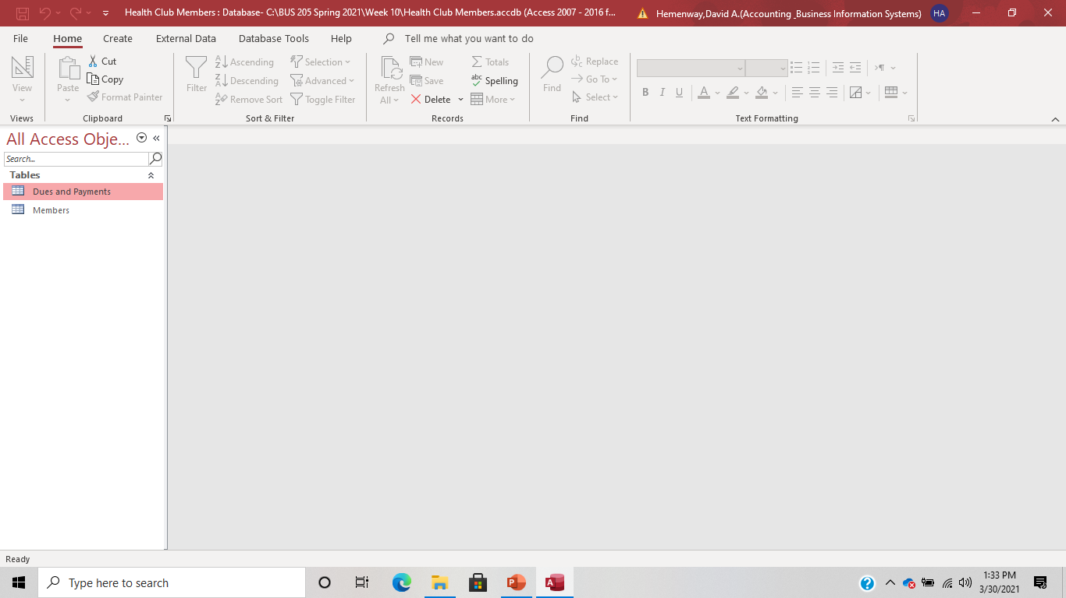
Get the Health Club Members Access database.

Slide 3
Referential Integrity
Ensures that data cannot be entered into a related table unless it first exists in the primary table. In the Health Club Members database, the primary table is the Members table and any other tables are secondary tables. The Dues and Payments table is a secondary table. If we are adding records to this database we must first enter the necessary data into the Members table before adding data into the Dues and Payments table. Of course, this is assuming Referential Integrity is turned on….which it should be!
Notes:
One of the most used methods for relationships is enforcing referential integrity. When referential integrity is enforced, you cannot enter a foreign key value in a related table unless the primary key value exists in the primary table. By selecting enforce referential integrity, Access ensures that data cannot be entered into a related table unless it first exists in the primary table.
As an example, a bank would not want to create a new loan record for a customer who does not yet exist in the customer table. A loan not related to a customer does not make sense, so by enforcing referential integrity, the customer must be placed in the Customer table before the loan can be entered into the Loan table. The Loan table uses CustomerID as the foreign key, which links back to the CustomerID in the Customer table.

Slide 4
Two Ways to Enter Data Into Access
1) Datasheet View
2) Using a Form

Slide 5
Advantages of Using Datasheet View:
Many records appear simultaneously.
You can compare data easily between records.
You can sort and filter by column.
You can scroll up and down to locate records. Source: Weverka, Peter, Microsoft Office 2019, 2019

Slide 6
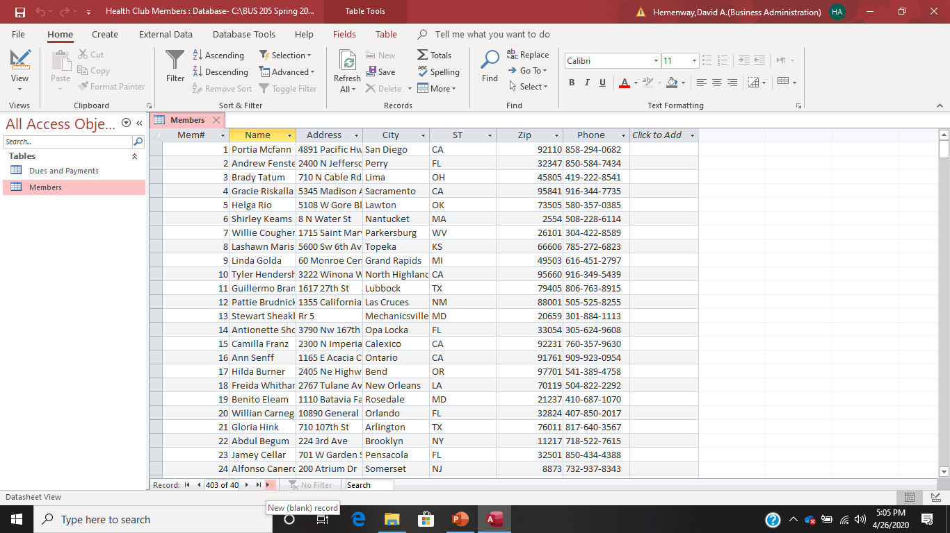
Ways of Entering a New Record in Datasheet View

Slide 7
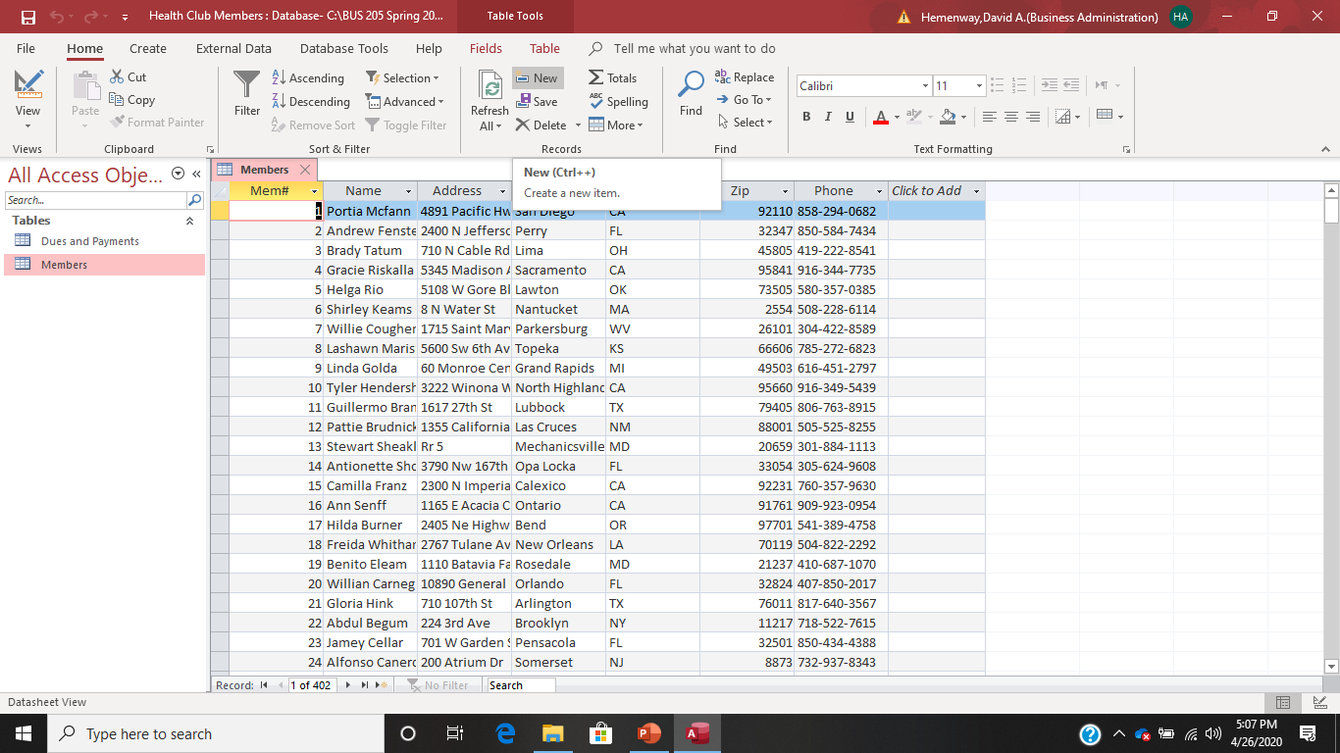
Ways of Entering a New Record in Datasheet View

Slide 8
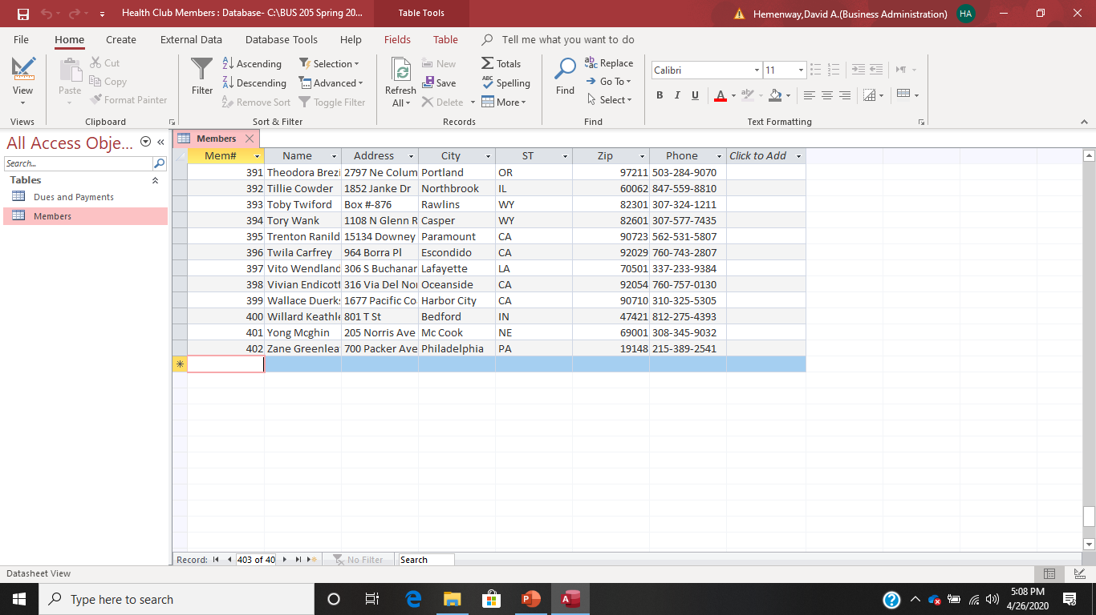
Ways of Entering a New Record in Datasheet View

Slide 9
If You Mess Up a Record When Entering It
Hit the ESC key before entering it.

Slide 10
When you are finished entering the data for a record:
When you are done entering the data into the fields, simply hit the Enter key on your keyboard. Access will automatically save the record for you!
How is this different than Excel?

Slide 11
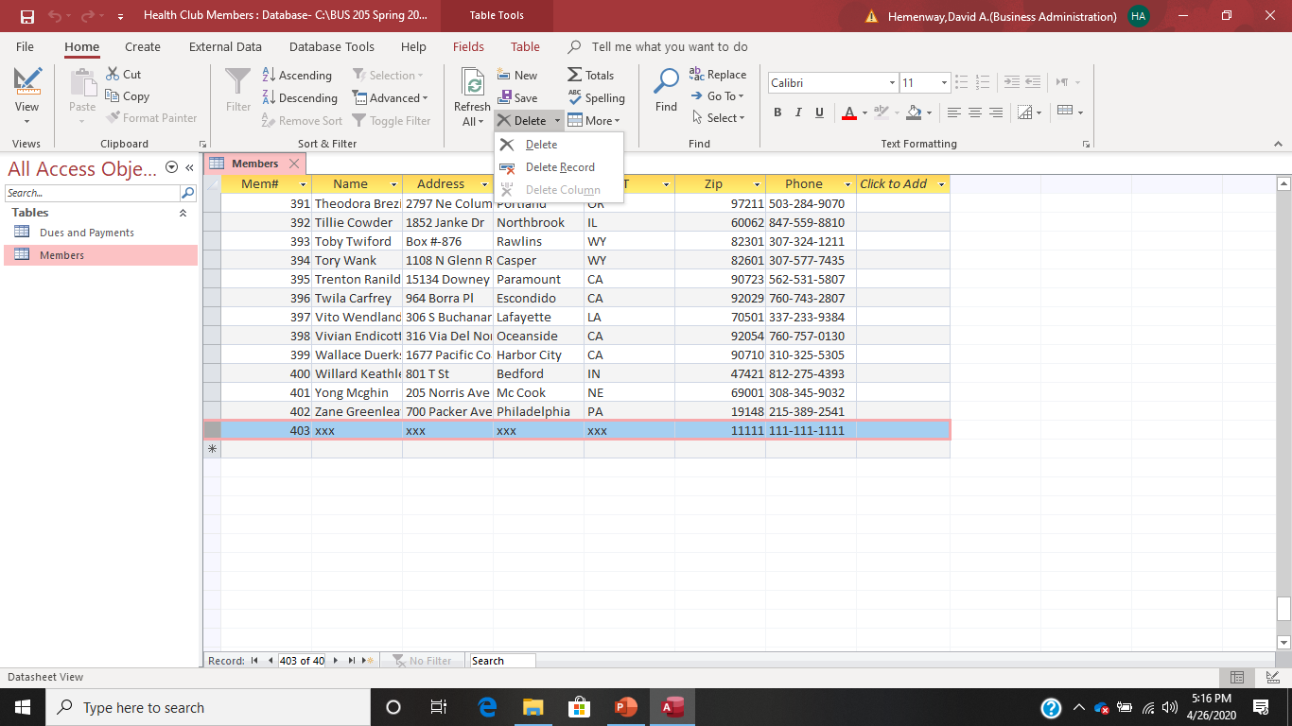
If you mess up a new record and it has been saved in the database, highlight the record, go to the Records area and select delete.

Slide 12
Datasheet Shortcuts
Press To Move…
Up arrow To the previous record. You can also press the Previous button on the Navigation buttons.
Down arrow To the next record. You can also press the Next button.
Tab or Enter To the next field in the record.
Shift+Tab To the previous field in the record.
Home To the first field in the record.
End To the last field in the record.
Ctrl+Home To the first field in the first record. You can also press the First button.
Page Up Up one screen.
Page Down Down one screen.
Source: Weverka, Peter, Microsoft Office 2019, 2019

Slide 13
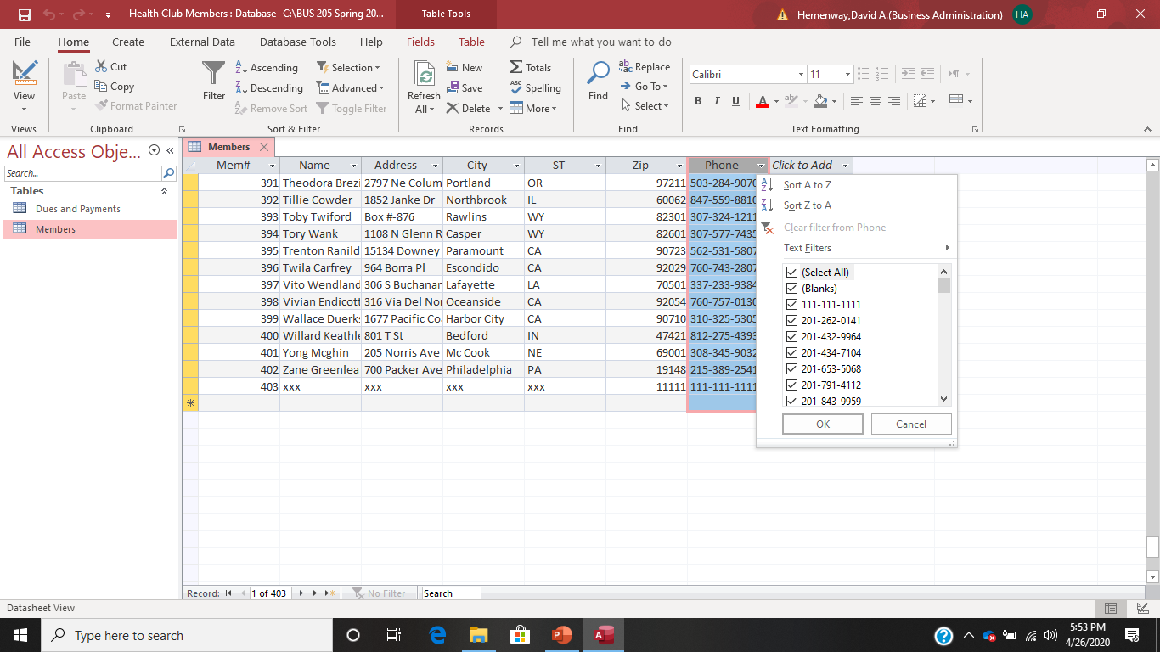
If you select the down arrow in a field name:

Slide 14
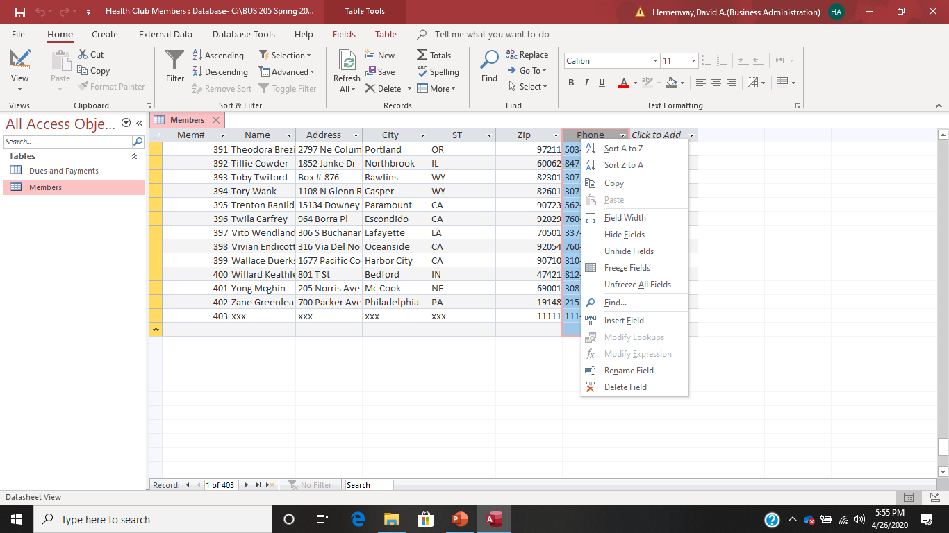
If you right click in a field name:

Slide 15
Entering Data with Datasheet View Challenges
A record in one table can be entered without corresponding data in another table if Referential Integrity is turned off. If Referential Integrity is turned on and you enter the primary table first, Access does NOT force you to enter the secondary tables.
Entering data into a table with many fields can be confusing because you can’t see all the fields. Possible solutions are: A. Hiding columns of variables. Highlight the columns you want to hide, right click.
B. Freezing columns of variables. Highlight the column you want to freeze, right click.
C. Change the size of the columns. Put your cursor on the edge of the column and drag it to the desired with.

Slide 16
An Access Data Viewing/Entry form is a form that is easily made using Form Wizard that allows you to view and/or enter data into a database. It can view and/or enter data from multiple tables.

Slide 17
Advantages of Using an Access Form:
You can list ALL the fields in one place and force the user to enter them all in one form.
You don’t have to scroll left or right to see all the fields.
Getting from field to field is easier.
Fields are clearly labeled so that you can always know what to enter.
You can see fields from multiple tables on one form. Source: Weverka, Peter, Microsoft Office 2019, 2019

Slide 18
Data Entry Form Creation Steps
Create
Form Wizard
Select tables
Select fields
Select Columnar option
Name form
Finish

Slide 19
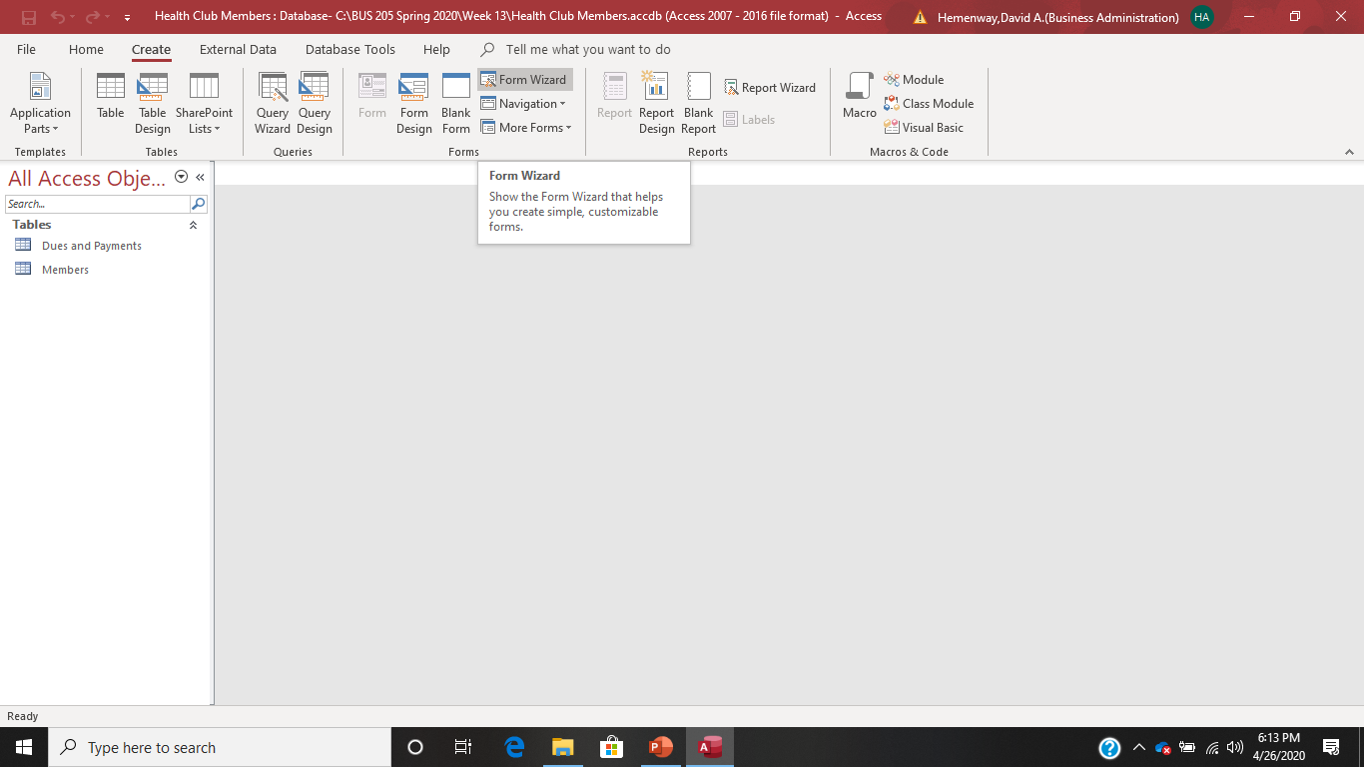
Forms Step 1- Select Create and then Form Wizard

Slide 20
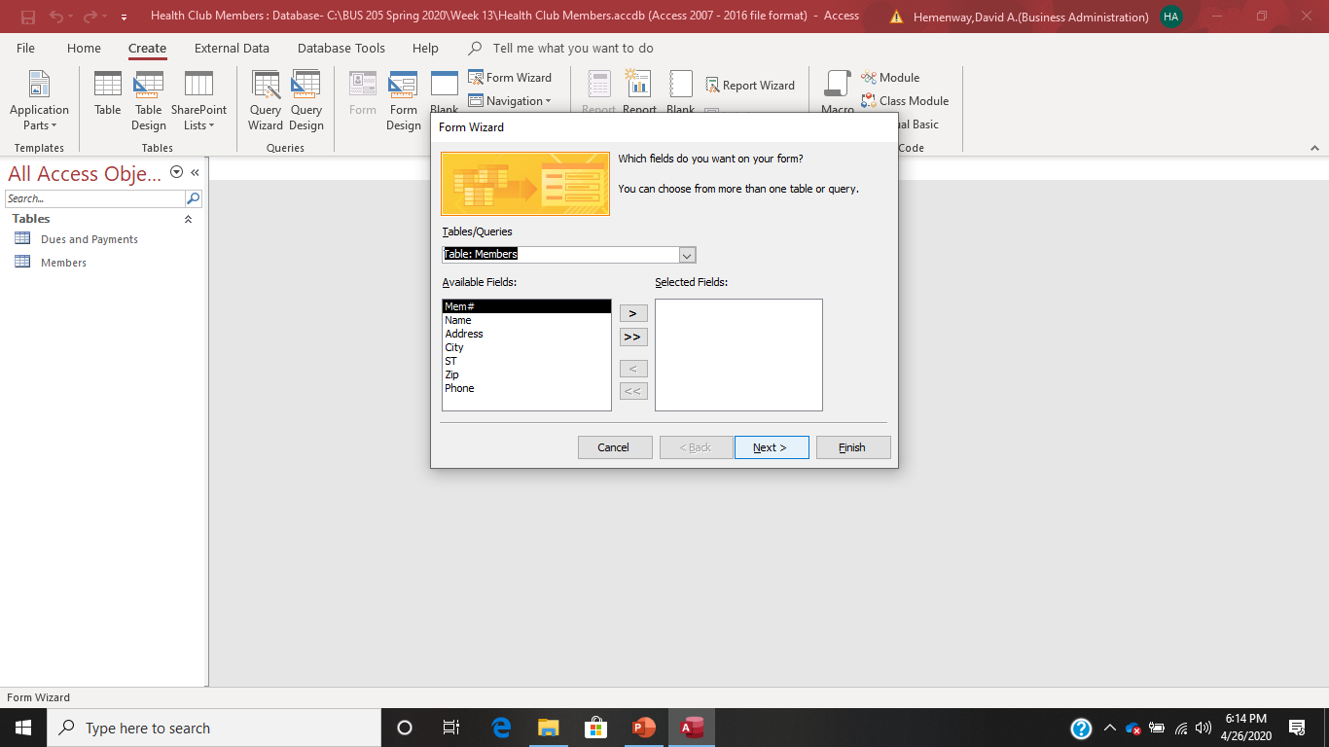
Forms Step 2 – Select the field(s) from each table(s) that you want in your form in the order you want them to appear on the form

Slide 21
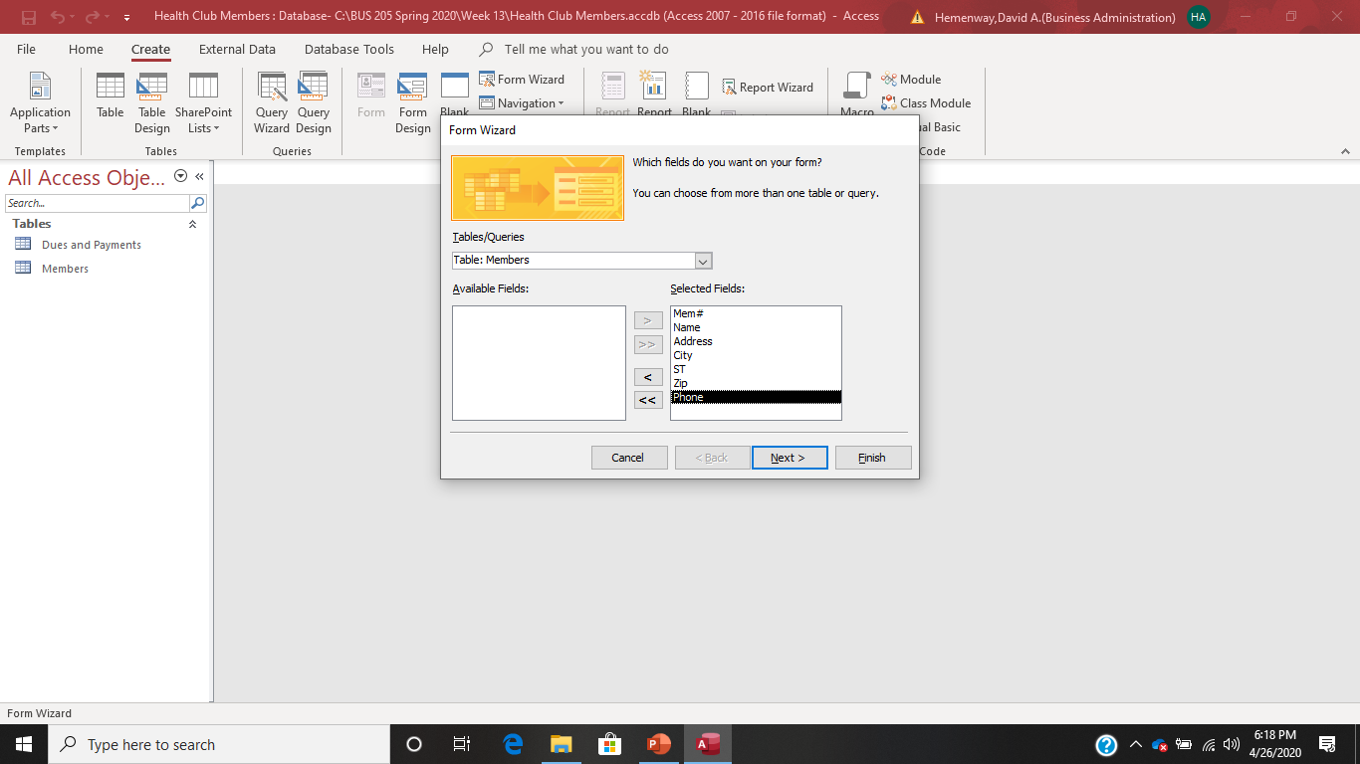
Forms Step 2 Continued – Select all the fields from the Members table and then all the fields from the Dues and Payments table because we want to enter them in that order.

Slide 22

Forms Step 2 Continued – Select all the fields from the Members table and then all the fields from the Dues and Payments table because we want to enter them in that order. Then select Next

Slide 23
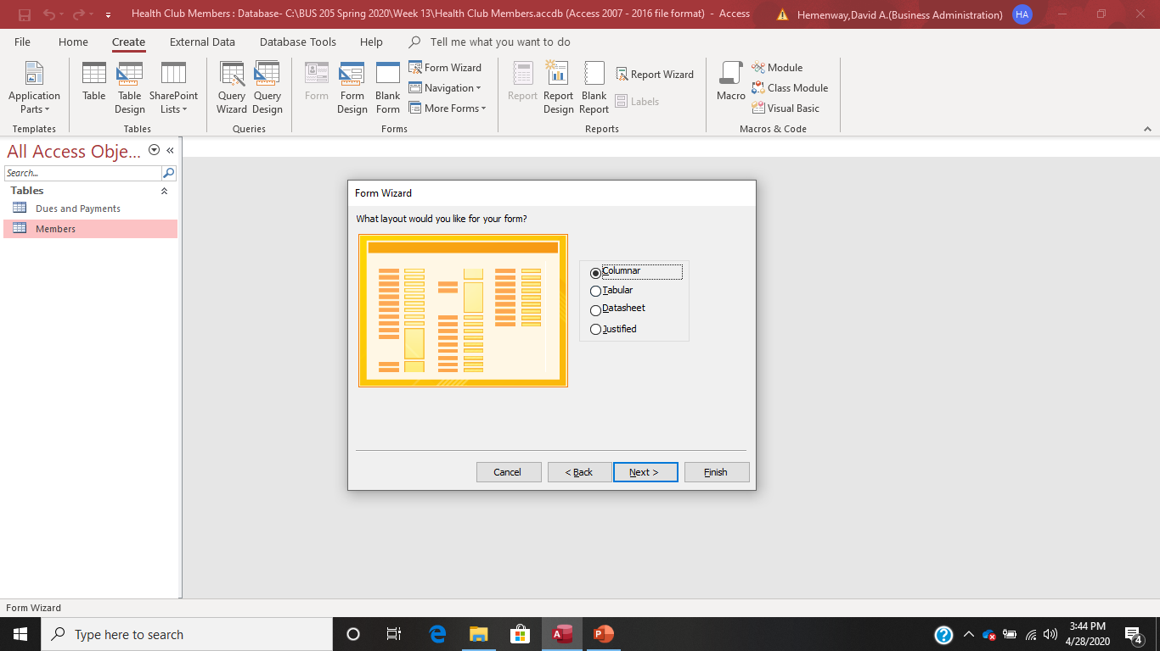
Forms Step 3 – Now select Columnar and select Next

Slide 24
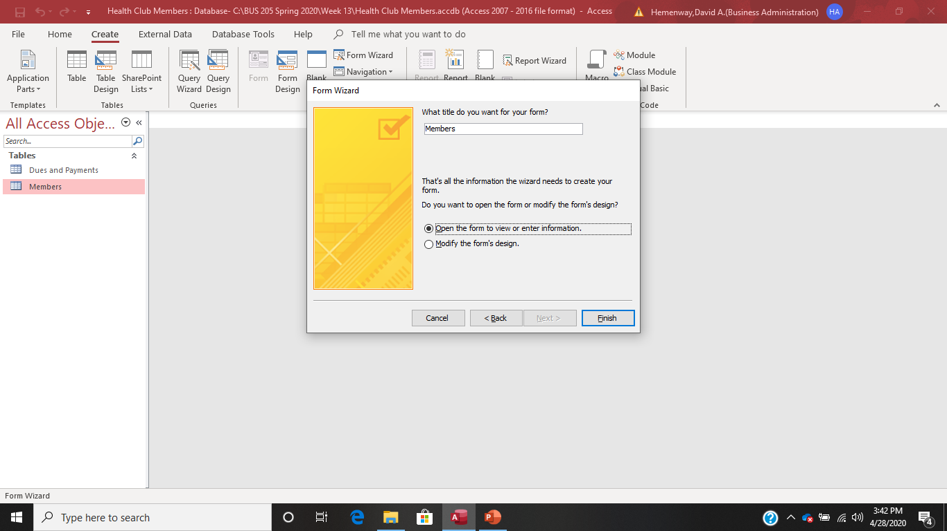
Step 4 – Select Finish which saves your form and opens it.

Slide 25
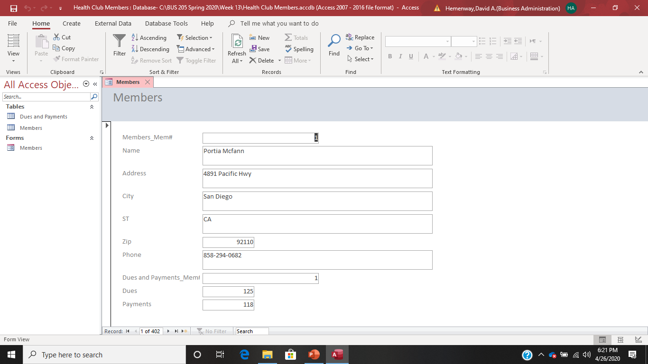
The result is a form that looks like this displaying the first record in the database

Slide 26

Notice that Access has automatically saved this form for you!

Slide 27

If you want to go to the next record, select the right arrow beside the record count information:

Slide 28

If you want to add a record, select the right arrow with a yellow * in it:

Slide 29
Advantages of Using an Access Form:
You can list ALL the fields in one place and force the user to enter them all in one form.
You don’t have to scroll left or right to see all the fields.
Getting from field to field is easier.
Fields are clearly labeled so that you can always know what to enter.
You can see fields from multiple tables on one form.
What else Source: Weverka, Peter, Microsoft Office 2019, 2019

Slide 30

Now that you have done all this hard work, It’s time to go kayaking with Cappy!

